Slide 1
Crime In Buffalo
Time Series analysis forecasting number of crimes using unemployment data

Slide 2
Crime predictions:

Slide 3
Data Mining
NYS Unemployment Data
https://data.ny.gov/Economic-Development/Local-Area-Unemployment-Statistics-Beginning-1976/5hyu-bdh8

Slide 4
Data Mining
NYS Unemployment Data
https://data.ny.gov/Economic-Development/Local-Area-Unemployment-Statistics-Beginning-1976/5hyu-bdh8
Buffalo Crimes reporting data
https://data.buffalony.gov/Public-Safety/Crime-Incidents/d6g9-xbgu/data

Slide 5
Data Transformation

Slide 6
Data Transformation
Reduction to overarching categories

Slide 7
Data Transformation
Reduction to overarching categories
Transforming from individual reporting to monthly reporting to match unemployment data

Slide 8
Data Transformation
Reduction to overarching categories
Transforming from individual reporting to monthly reporting to match unemployment data
Joining with unemployment data.

Slide 9
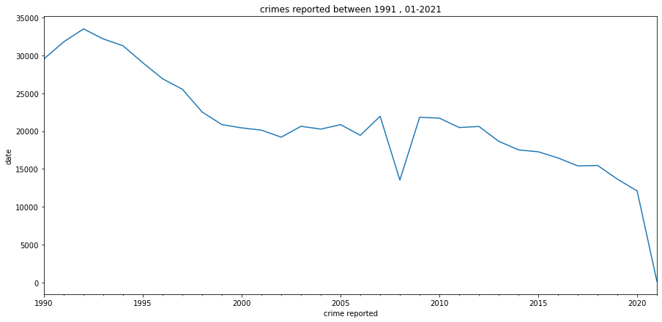
EDA
Clear Trend in the data
Crime is trending lower

Slide 10
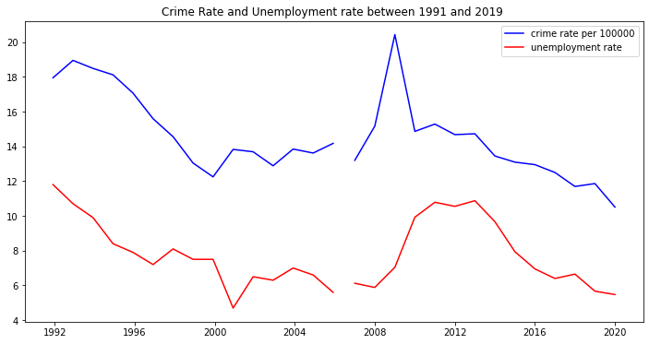
EDA
Correlation between crime and unemployment is extremely obvious up until 2020.

Slide 11
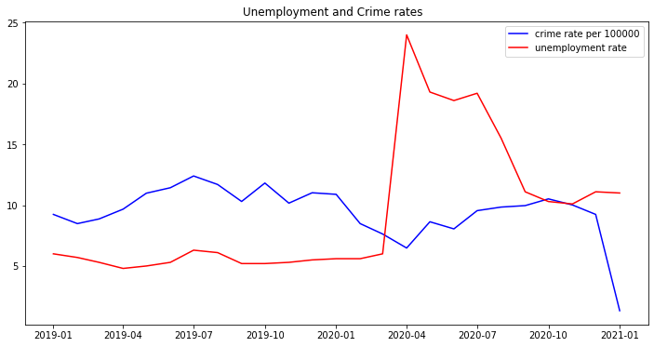
Anomaly
During 2020 correlation decoupled due to the Corona virus pandemic.
Unemployment spiked while crime maintained its moving average.

Slide 12
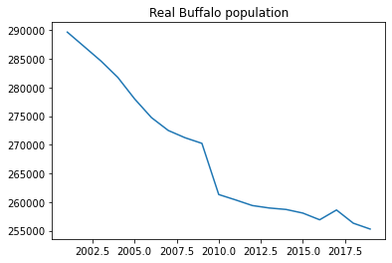
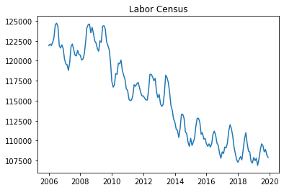
EDA
The trend in crime could be explained via population census.

Slide 13
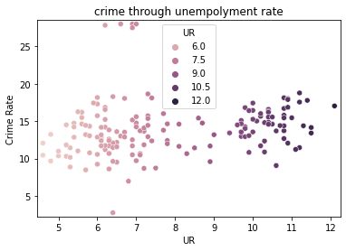
EDA
From this vantage point , crime and Unemployment are not really showing any correlation.

Slide 14
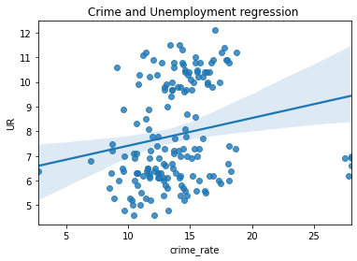
EDA
No correlation !

Slide 15
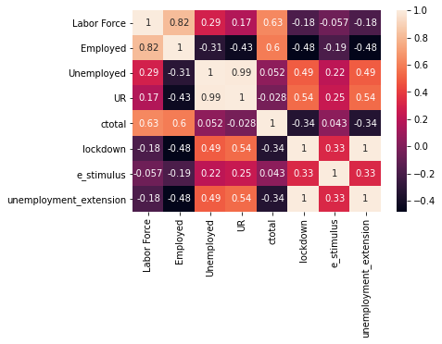
Correlations
largest correlations with crime total are:
Labor force at 0.63
Employed at 0.6
Unemployed 0.052

Slide 16
Modeling
The initial Model selected was ARIMA (Auto Regressive Moving Average)

Slide 17
Modeling
The initial Model selected was ARIMA (Auto Regressive Moving Average)
ARIMA models require sets on inputs that are : p(AR),q(differencing),d(MA)

Slide 18
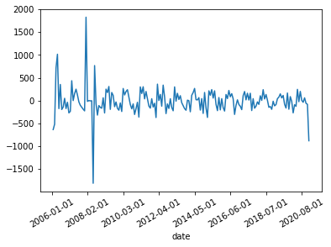
Modeling
The difference is found by remove the trend and transforming the data a static form .
Usually achieved by calculating the difference between the data set and the same data set lagged.

Slide 19
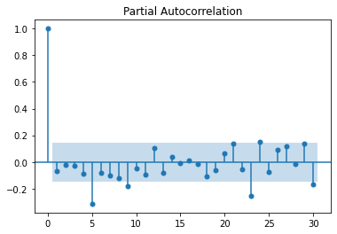
Deciding the type of ARIMA
Auto correlation and partial auto correlation functions show the necessity for ARMA model , since the data flow isn’t uniform.

Slide 20
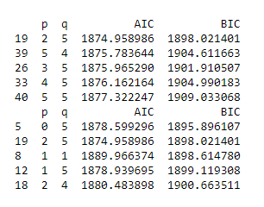
Modeling
Next steps finding the p and q.
Using AIC,BIC grid search
selected the lower AIC for better prediction.

Slide 21
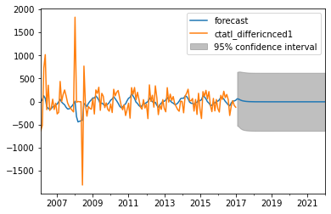
ARIMA Prediction
ARIMA predicted a moving average.
Not good enough

Slide 22
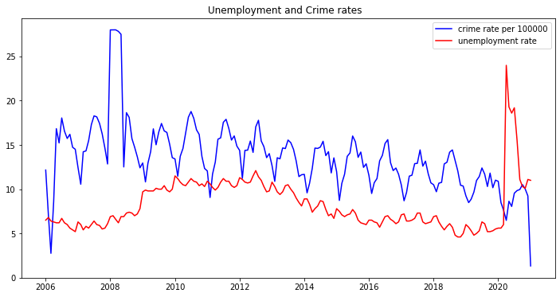
Seasonality in the data
Every years seems to have to cycles that are almost oscillating between a semi static margins.

Slide 23
Modeling
Since the data is seasonal SARIMAX is a better predictor since it considers seasonality and could also include exogenous variables.
SARIMAX requires a seasonal order of P,D,Q,s
We already have the P,D,Q

Slide 24
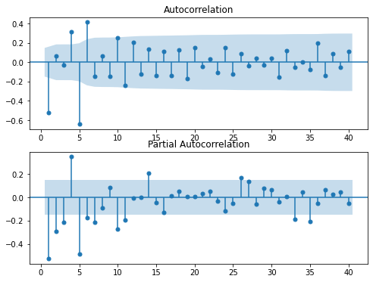
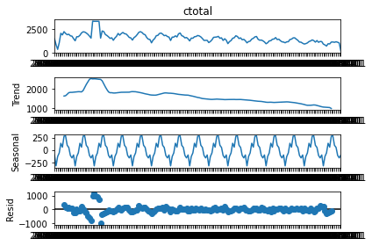
Seasonal Order
Seasonal Order requires decomposition , Auto Correlation ,Partial Autocorrelation plots.

Slide 25
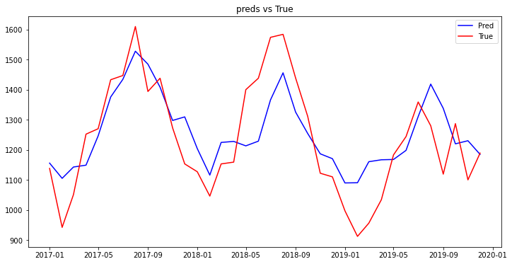
Prediction
The SARIMAX Model was able to predict at an accuracy of 91.9%.
Mape: 8.0411

Slide 26
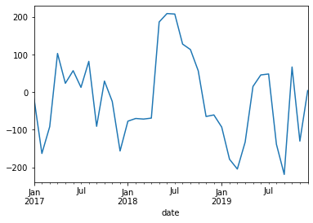
Prediction Residual

Slide 27
Conclusions
There are a few patterns that couldn’t be captured with current data.
Predictions are good with margin of error of 10%

